Slide 1



SyriaTel Customer Churn Analysis
Project Collaborators:
Ivy Kemunto
Loise Mbago
Aisha Mbarak
Daniel Ndirangu
Judith Waguma
Stanley Weru
Bernard Mucui
Date: July 2023

Slide 2



BUSINESS PROBLEM
Customer churn poses a significant threat to SyriaTel and the telecommunications industry at large. The loss of customers not only leads to immediate revenue reduction but also incurs additional costs associated with acquiring new customers.

Slide 3
PROJECT OBJECTIVES
Build a precise churn prediction model to reduce customer attrition effectively.
01
Utilize the model's predictions to implement strategies that effectively reduce customer attrition at SyriaTel.
02
Optimize SyriaTel's retention strategies and resources to reduce customer churn, enhance loyalty, and boost profitability.
03

Slide 4
DATA UNDERSTANDING
The SyriaTel Dataset was retrieved from Kaggle. It contains information on about 3,333 customers.
The data includes various details like the state the customer is from, how long they've been a customer, whether they have an international plan or voice mail plan, how many customer service calls they've made, and many more.
Assumptions made:
All of the data was captured at one point in time.
The data represents a bill over a one month duration.
Each phone number represents one account.
The company is charging in dollars.
Account length is in terms of months.

Slide 5
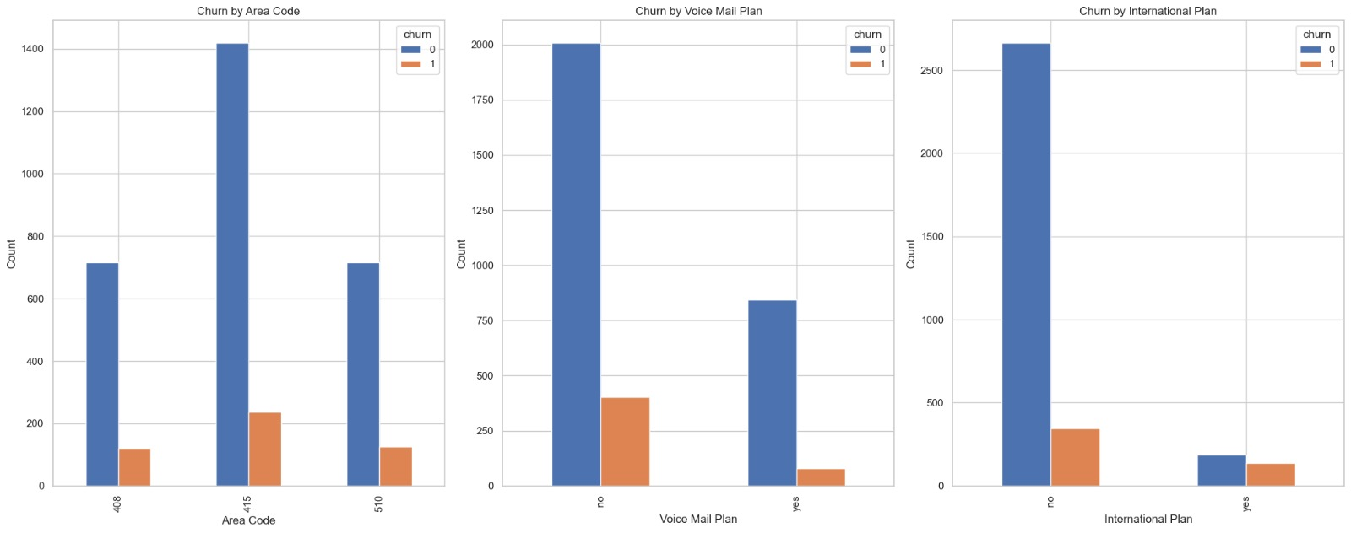
EXPLORATORY DATA ANALYSIS
Churn Rate By Area Code , Voice Mail Plan And International Plan

Slide 6
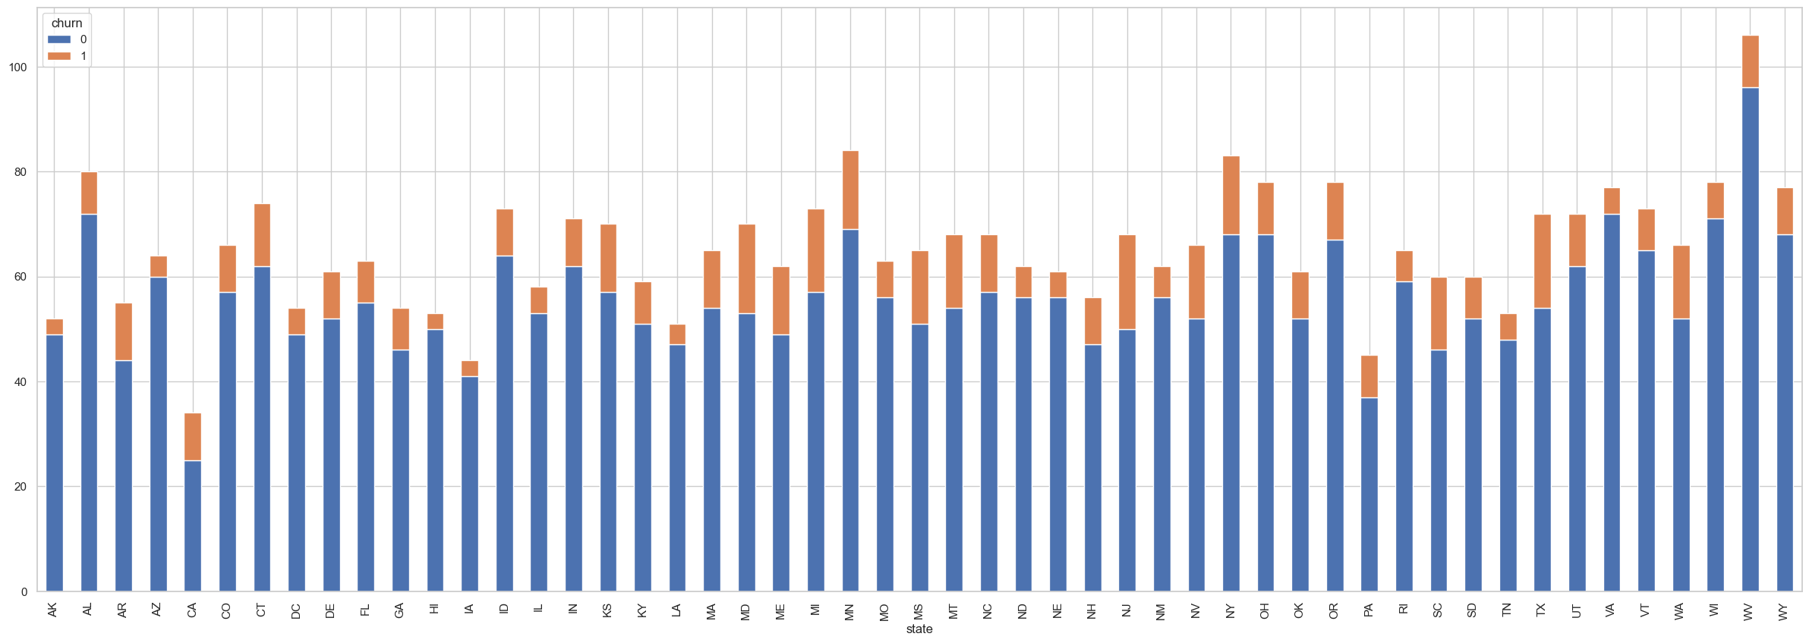
CHURN BY STATE
The plot above shows the distribution of churn for each state.
Some states have relatively higher churn rates like WV, VT, NY, OH with a significant number of churned customers (churn 1) while other states have lower churn rates like AR, AZ, CA, CO with a higher count of customers who did not churn (churn 0)

Slide 7
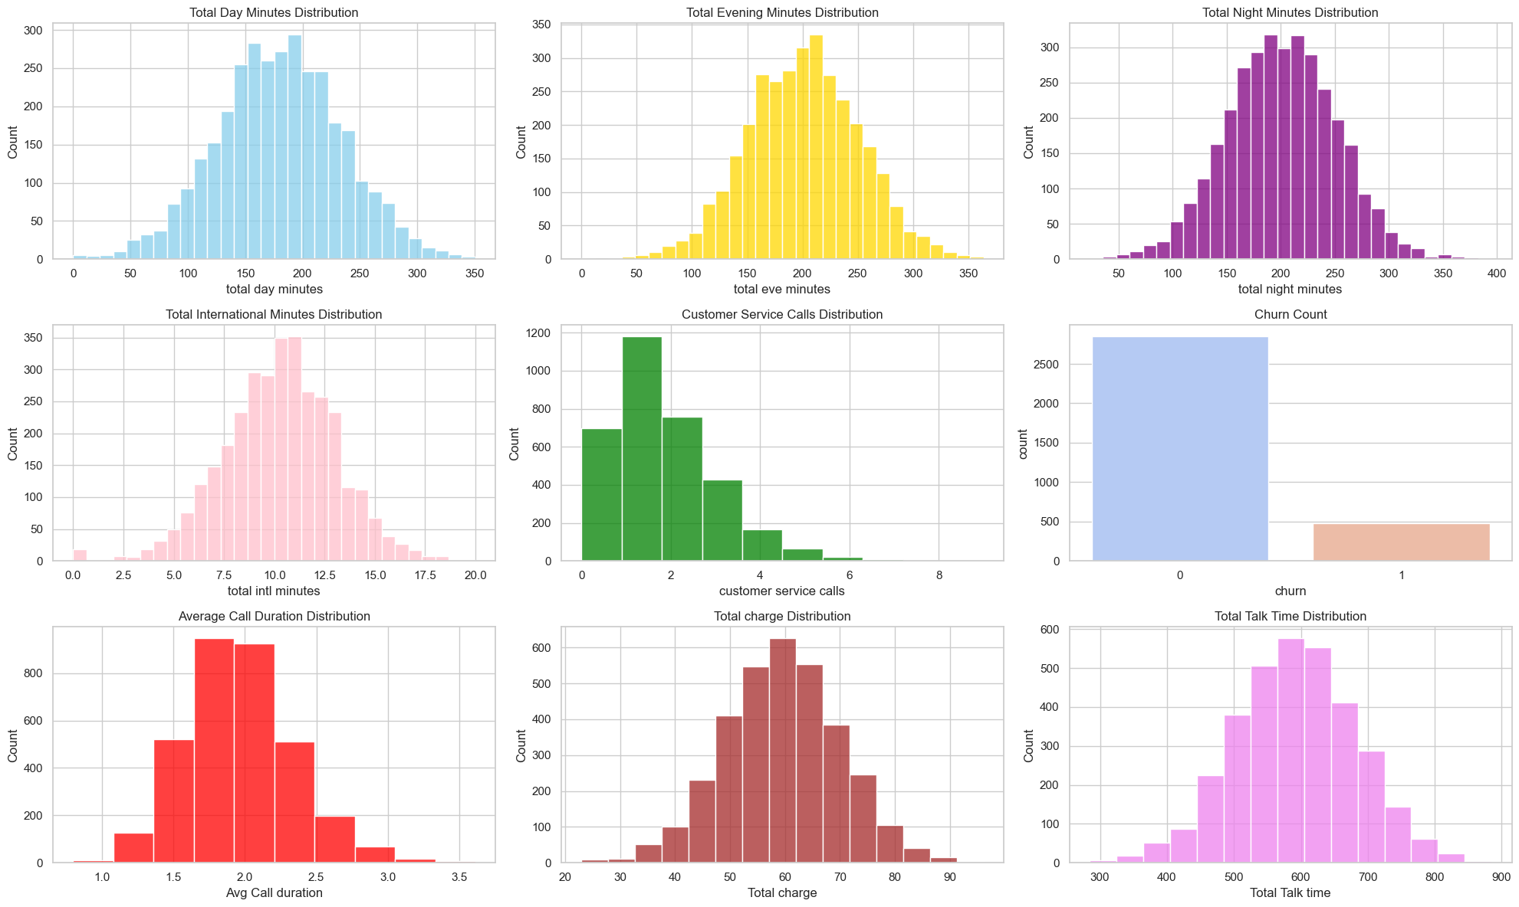
Distribution of Numerical Features

Slide 8
Modeling Approach
Four binary classification models - Logistic Regression, Random Forest, Gradient Boosting, and Decision Tree - were used, trained on a resampled dataset, and optimized with hyperparameter tuning.
Tuned Results
 |  | Accuracy | Precision | Recall | F1-score
Logistic Regression | Test | 0.86 | 0.52 | 0.41 | 00.46
 | Train | 0.768592 | 0.326718 | 0.554404 | 0.411143
Random Forest | Test | 0.91 | 0.73 | 0.56 | 0.64
 | Train | 1.000000 | 1.000000 | 1.000000 | 1.000000
Gradient Boosting | Test | 0.95 | 0.92 | 0.75 | 0.83
 | Train | 0.975840 | 0.976331 | 0.854922 | 0.911602
Decision Tree Classifier | Test | 0.9125 | 0.6900 | 0.7188 | 0.7041
 | Train | 0.9764 | 0.9887 | 0.9638 | 0.9761

Slide 9
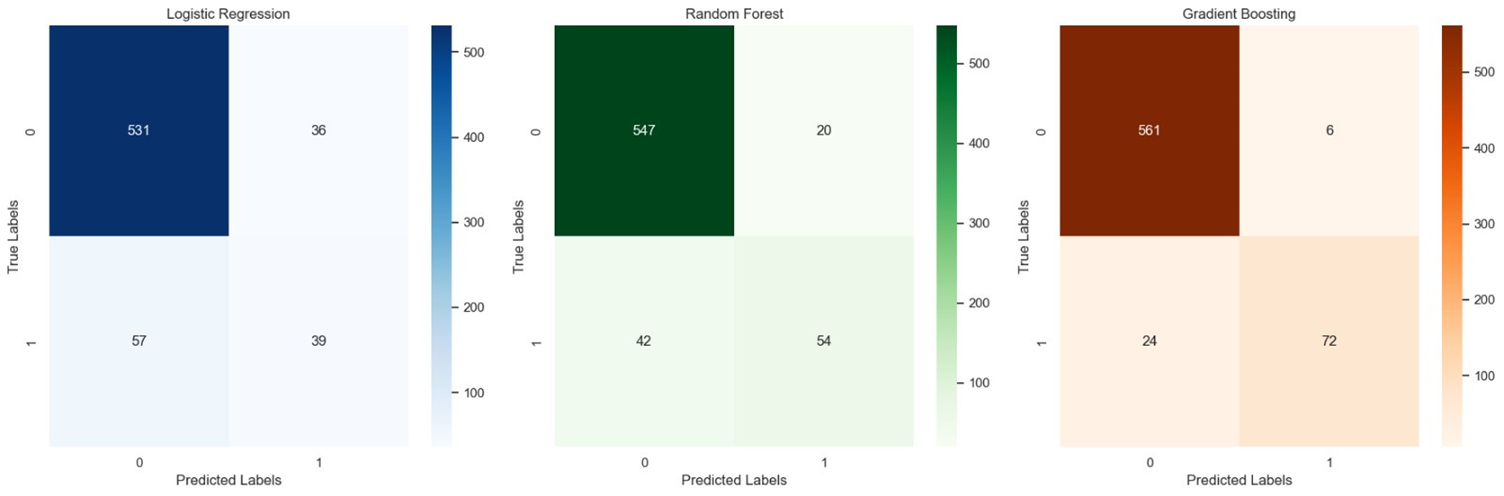
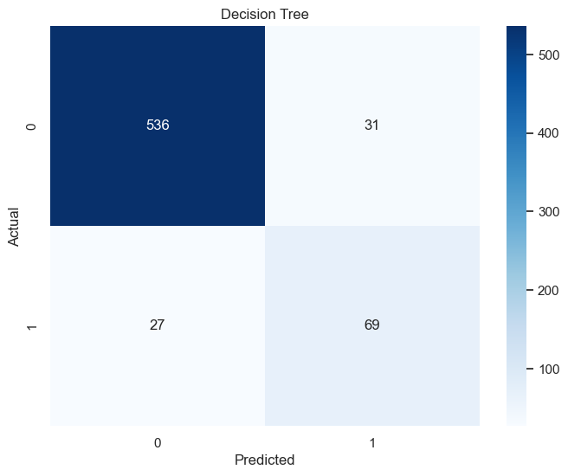
04
Model Performance Evaluation
The Gradient Boosting model demonstrates excellent performance with an accuracy of 96.08% and a balanced F1-score of 85.87%, indicating effective identification of churn cases while minimizing false positives.

Slide 10
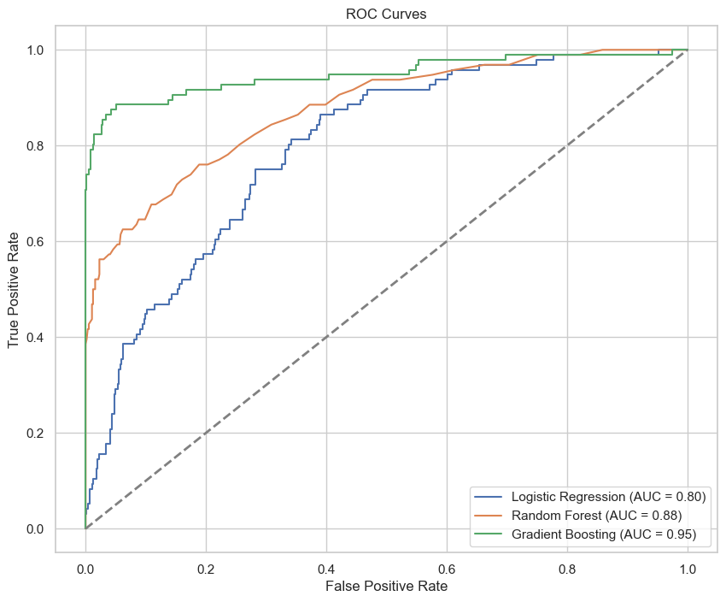
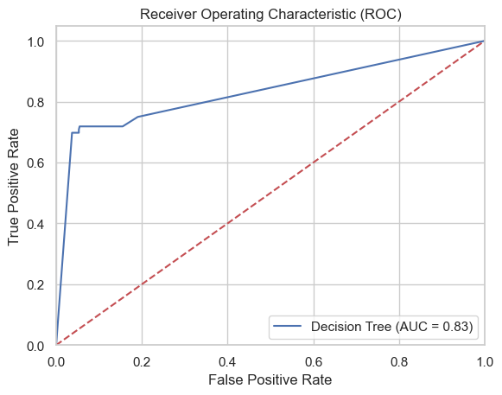
04
ROC Curves for the Tuned Models

Slide 11

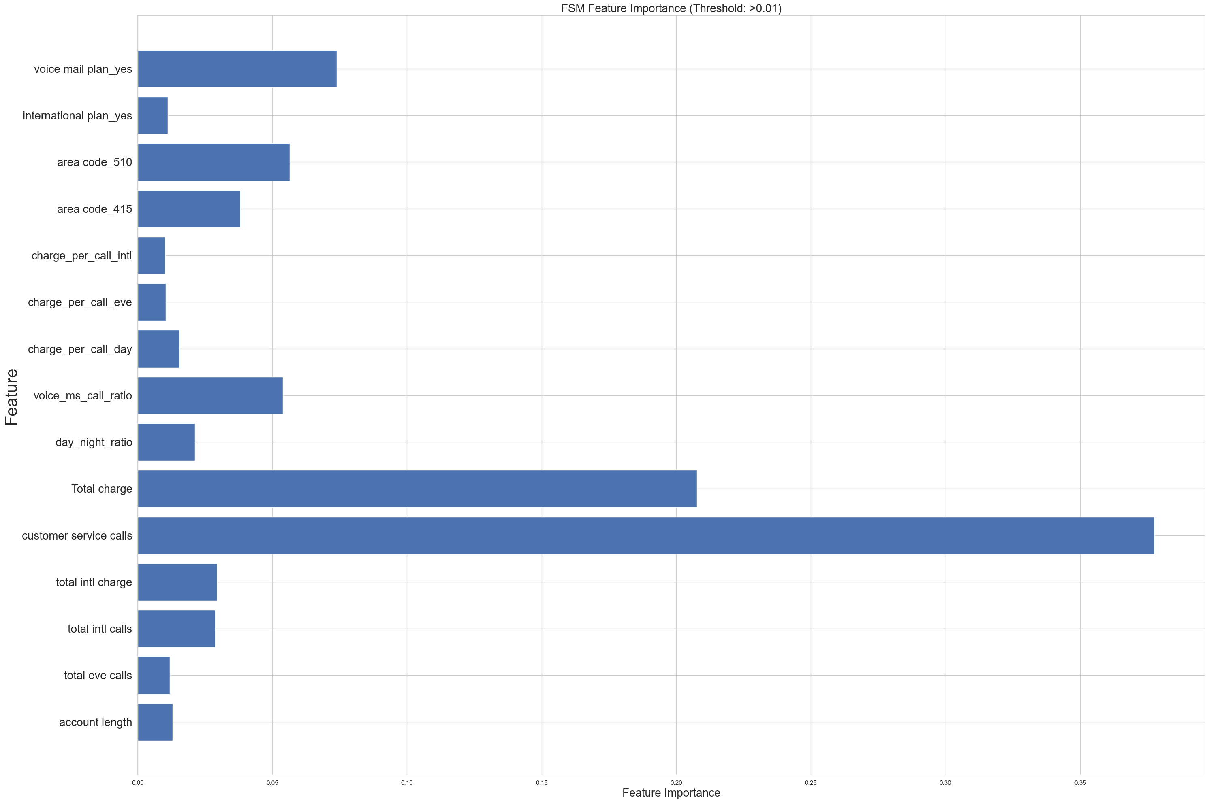
IMPORTANT FEATURE SELECTION

Slide 12
OBSERVATIONS/FINDINGS
Model Performance:
The models, especially Gradient Boosting, show good performance with an accuracy of 96.07% and recall of 82.2%. Decision Tree's tuning improved accuracy but reduced recall.
Key Features:
'International_plan’,voicemail plan, 'total_charge', and 'customer_service_calls' are the top features influencing churn prediction. This suggests that customers with an international plan, those who have a high total charge, and those who have made more customer service calls are more likely to churn

Slide 13

RECOMMENDATIONS
Based on our findings, we recommend the following:
Review Voice Mail Plan
Review International Plan:
Improve Customer Service:
Analyze Pricing Structure:

Slide 14
FUTURE WORK:
Deep Dive into Churn Reasons:
A more in-depth analysis of the reasons behind churn could be beneficial. This could involve surveys or interviews with customers who have churned to understand their reasons for leaving.
Predicting Churn Well in Advance:
It could be beneficial to not only predict which customers will churn but also when they will churn. This could allow Syriatel to intervene with retention strategies before it's too late.
Retention Strategy Implementation & Evaluation:
After identifying customers who are likely to churn, the next step would be to implement retention strategies and then evaluate their effectiveness. This could involve A/B testing or other methods to measure the impact of these strategies on customer retention.

Slide 15

Thank You

